Slide 1
Regression Modeling Basics

Slide 2
Regression Analysis
Regression analysis is the ART and SCIENCE of fitting straight lines to patterns of data.
If Y denotes the dependent variable, and X1, …, Xk, are the independent variables, then the assumption is that the value of Y at time t (or row t) in the data sample is determined by the linear equation.
where the betas are constants and the epsilons are independent and identically distributed (i.i.d.) normal random variables with mean zero (the “noise” in the system).
β0 is the so-called intercept of the model—the expected value of Y when all the X’s are zero—and
βi is the coefficient (multiplier) of the variable Xi. The betas together with the mean and standard deviation of the epsilons are the parameters

Slide 3
Linear Regression
The expected value of Y is a linear function of the X variables. This means:
if Xi changes by an amount ΔXi, holding other variables fixed, then the expected value of Y changes by a proportional amount βiΔXi, for some constant βi (which in general could be a positive or negative number).
The value of βi is always the same, regardless of values of the other X’s.
The total effect of the X’s on the expected value of Y is the sum of their separate effects.
The unexplained variations of Y are independent random variables.
They all have the same variance (“homoscedasticity”).
They are normally distributed.
No model is perfect—these assumptions will never be exactly satisfied by real-world messy data—but you hope that they are not badly wrong.

Slide 4
Linear Model
The regression model makes very strong assumptions about the WAY in which Y depends on the X’s, namely that the causal or predictive effects of the X’s with respect to Y are linear and additive and non-interactive and that any variations in Y that are not explained by the X’s are statistically independent of each other and identically normally distributed under all conditions.
The ART of regression modelling is to (most importantly!) collect data that is relevant and informative with respect to your decision or inference problem, and then define your variables and construct your model in such a way that the assumptions listed above are plausible, at least as a first-order approximation to what is really happening.

Slide 5
Example
Selection and Placement During the World Wars
Technology helped the United States and her allies to win the first and second world wars. One usually thinks of the atomic bomb, radar, bombsights, better designed aircraft, etc when this statement is made. Less well known were the contributions of psychologists and associated scientists to the development of test and prediction models used for selection and placement of men and women in the armed forces.
During these wars, the United States had thousands of men and women enlisting or being drafted into the military. These individuals differed in their ability to perform physical and intellectual tasks. The problem was one of both selection, who is drafted and who is rejected, and placement, of those selected, who will cook and who will fight. The army that takes its best and brightest men and women and places them in the front lines digging trenches is less likely to win the war than the army who places these men and women in the position of leadership.

Slide 6
Examples
Manufacturing Widgets
A new plant to manufacture widgets is being located in a nearby community.
The plant personnel officer advertises the employment opportunity and the next morning has 10,000 people waiting to apply for the 1,000 available jobs.
It is important to select the 1,000 people who will make the best employees because training takes time and money and firing is difficult and bad for community relations.
In order to provide information to help make the correct decisions, the personnel officer employs a regression model.

Slide 7
Regression Model Description
X_{i} is the variable used to predict, and is sometimes called the independent variable. In the case of the widget manufacturing example, it would be the test score.
Y_{i} is the observed value of the predicted variable, and is sometimes called the dependent variable. In the example, it would be the number of widgets produced per hour by that individual.
Y'_{i} is the predicted value of the dependent variable. In the example it would be the predicted number of widgets per hour by that individual.
The goal in the regression procedure is to create a model where the predicted and observed values of the variable to be predicted are as similar as possible. For example, in the widget manufacturing situation, it is desired that the predicted number of widgets made per hour be as similar to observed values as possible. The more similar these two values, the better the model

Slide 8
THE LEAST-SQUARES CRITERIA FOR GOODNESS-OF-FIT
In order to develop a measure of how well a model predicts the data, it is valuable to present an analogy of how to evaluate predictions.
Suppose there were two interviewers, Mr. A and Ms. B, who separately interviewed each applicant for the widget manufacturing job for ten minutes. At the end of that time, the interviewer had to make a prediction about how many widgets that applicant would produce two months later.
All of the applicants interviewed were hired, regardless of the predictions, and at the end of the two month's trial period, one interviewer, the best one, was to be retained and promoted, the other was to be fired. The purpose of the following is to develop a measure of goodness-of-fit, or, how well the interviewer predicted.

Slide 9
GOODNESS-OF-FIT
The notational scheme for the table is as follows:
Y_{i} is the observed or actual number of widgets made per hour
Y'_{i} is the predicted number of widgets
Suppose the data for the five applicants were as follows:
 | Interviewer
Observed | Mr. A | Ms. B
Y_{i} | Y'_{i} | Y'_{i}
23 | 38 | 21
18 | 34 | 15
35 | 16 | 32
10 | 10 | 8
27 | 14 | 23

Slide 10
GOODNESS-OF-FIT
The first step is to find how much each interviewer missed the predicted value for each applicant. This is done by finding the difference between the predicted and observed values for each applicant for each interviewer.

Slide 11
GOODNESS-OF-FIT
The first step is to find how much each interviewer missed the predicted value for each applicant. This is done by finding the difference between the predicted and observed values for each applicant for each interviewer.
These differences are called residuals.
 | Interviewer
Observed | Mr. A | Ms . B | Mr. A | Ms. B
Y_{i} | Y'_{i} | Y'_{i} | Y_{i} - Y'_{i} | Y_{i} - Y'_{i}
23 | 38 | 21 | -15 | 2
18 | 34 | 15 | -16 | 3
35 | 16 | 32 | 19 | 3
10 | 10 | 8 | 0 | 2
27 | 14 | 23 | 13 | 4
 |  |  | 1 | 14

Slide 12
GOODNESS-OF-FIT
If the column of differences between the observed and predicted is summed, then it would appear that interviewer A is the better at prediction, because he had a smaller sum of deviations, 1, than interviewer B, with a sum of 14.
This goes against common sense.
In this case large positive deviations cancel out large negative deviations, leaving what appears as an almost perfect prediction for interviewer A, but that is obviously not the case..
To avoid this problem procedure is ignore the signs of the differences and then sum, that is, take the sum of the absolute values. This would work, but for mathematical reasons the sign is eliminated by squaring the differences.

Slide 13

GOODNESS-OF-FIT
 | Interviewer
Obs | Mr. A | Ms . B | Mr. A | Ms. B | Mr. A | Ms. B
Y_{i} | Y'_{i} | Y'_{i} | Y_{i} - Y'_{i} | Y_{i} - Y'_{i} | (Y_{i} - Y'_{i})² | (Y_{i} - Y'_{i})²
23 | 38 | 21 | -15 | 2 | 225 | 4
18 | 34 | 15 | -16 | 3 | 256 | 9
35 | 16 | 32 | 19 | 3 | 361 | 9
10 | 10 | 8 | 0 | 2 | 0 | 4
27 | 14 | 23 | 13 | 4 | 169 | 16
 |  |  | 1 | 14 | 1011 | 42
Summing the squared differences yields the desired measure of goodness-of-fit. In this case the smaller the number, the closer the predicted to the observed values. This is expressed in the following mathematical equation.

Slide 14
THE REGRESSION MODEL
The situation using the regression model is analogous to that of the interviewers, except instead of using interviewers, predictions are made by performing a linear transformation of the predictor variable. Rather than interviewers in the above example, the predicted value would be obtained by a linear transformation of the score. The prediction takes the form
where a and b are parameters in the regression model.

Slide 15
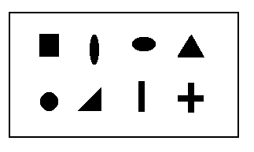
THE REGRESSION MODEL
Suppose that, rather than being interviewed each applicant took a form-board test. A form-board is a board with holes cut out in various shapes: square, round triangular, etc. The goal is to put the right pegs in the right holes as fast as possible. The saying "square peg in a round hole" came from this test, as the test has been around for a long time. The score for the test is the number of seconds it takes to complete putting all the pegs in the right holes.
The data was collected as follows:
Test Score | Widgets/hr
X_{i} | Y_{i}
13 | 23
20 | 18
10 | 35
33 | 10
15 | 27

Slide 16
THE REGRESSION MODEL
Because the two parameters of the regression model, a and b, can take on any real value, there are an infinite number of possible models, analogous to having an infinite number of possible interviewers. The goal of regression is to select the parameters of the model so that the least-squares criterion is met.
For the first model, let a=10 and b=1 attempting to predict the first score perfectly. In this case the regression model becomes
Form-Board | Widgets/hr |  | Residuals | Squared Residuals
Observed | Observed | Predicted
X_{i} | Y_{i} | Y'_{i}=a+bX_{i} | (Y_{i}-Y'_{i}) | (Y_{i}-Y'_{i})²
13 | 23 | 23 | 0 | 0
20 | 18 | 30 | -12 | 144
10 | 35 | 20 | 15 | 225
33 | 10 | 43 | -33 | 1089
15 | 27 | 25 | 2 | 4
 |  |  | (Y_{i}-Y'_{i})² | 1462
Because it is desired that the model work for all applicants, some other values for the parameters must be tried.

Slide 17
THE REGRESSION MODEL
The selections of the parameters for the second model is based on the observation that the longer it takes to put the form board together, the fewer the number of widgets made.
When the tendency is for one variable to increase while the other decreases, the relationship between the variables is said to be inverse. The mathematician knows that in order to model an inverse relationship, a negative value of b must be used in the regression model.
Lets try a=36 and b=-1
Xi | Yi | Y'i=a+bXi | (Yi-Y'i) | (Yi-Y'i)2
13 | 23 | 23 | 0 | 0
20 | 18 | 16 | 2 | 4
10 | 35 | 26 | 9 | 81
33 | 10 | 3 | 7 | 49
15 | 27 | 21 | 6 | 36
 |  |  | (Yi-Y'i)2 | 170

Slide 18
THE REGRESSION MODEL
Fairly large deviations are noted for the third applicant, which might be reduced by increasing the value of the additive component of the transformation, a. Thus a model with a=41 and b=-1 will now be tried.
X_{i} | Y_{i} | Y'_{i}=a+bX_{i} | (Y_{i}-Y'_{i}) | (Y_{i}-Y'_{i})²
13 | 23 | 28 | -5 | 25
20 | 18 | 21 | -3 | 19
10 | 35 | 31 | 4 | 16
33 | 10 | 8 | 2 | 4
15 | 27 | 26 | 1 | 1
 |  |  | (Y_{i}-Y'_{i})² | 55
It is still a better solution than previous
"When do we know when to stop?"

Slide 19
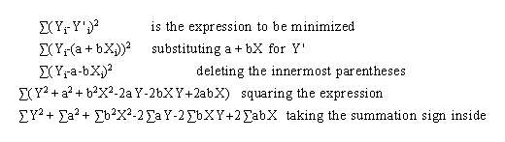

THE REGRESSION MODEL
The mathematical problem can be stated as follows:
"The values of a and b in the linear model Y'_{i} = a + b X_{i} are to be found which minimize the algebraic expression

Slide 20
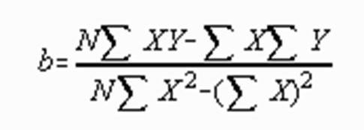
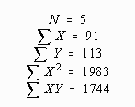
THE REGRESSION MODEL
 | X_{i} | Y_{i} | X_{i}² | X_{i}Y_{i}
 | 13 | 23 | 169 | 299
 | 20 | 18 | 400 | 360
 | 10 | 35 | 100 | 350
 | 33 | 10 | 1089 | 330
 | 15 | 27 | 225 | 405
SUM | 91 | 113 | 1983 | 1744

Slide 21
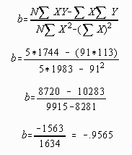
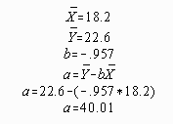
GOODNESS-OF-FIT
This procedure results in an "optimal" model. That is, no other values of a and b will yield a smaller sum of squared deviations.

Slide 22
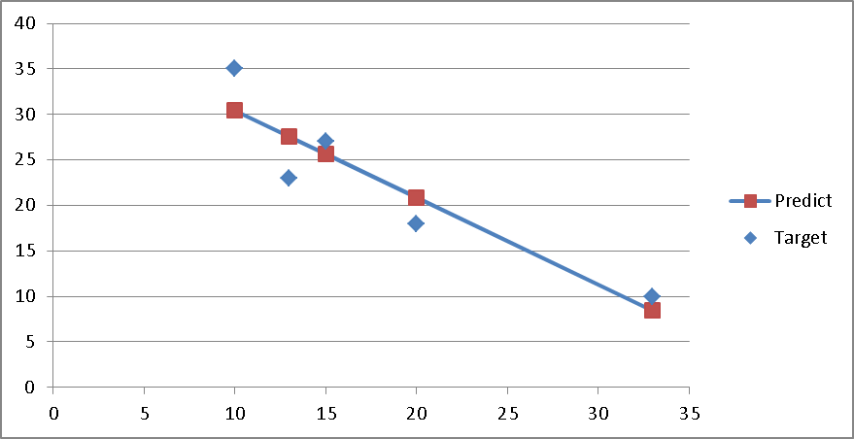
THE REGRESSION MODEL

Slide 23

THE STANDARD ERROR OF ESTIMATE
The standard error of estimate is a measure of error in prediction
The standard error of estimate is a standard deviation type of measure. Note the similarity of the definitional formula of the standard deviation of Y to the definitional formula for the standard error of measurement.
Two differences appear.
First, the standard error of measurement divides the sum of squared deviations by N-2, rather than N-1.
Second, the standard error of measurement finds the sum of squared differences around a predicted value of Y, rather than the mean.

Slide 24
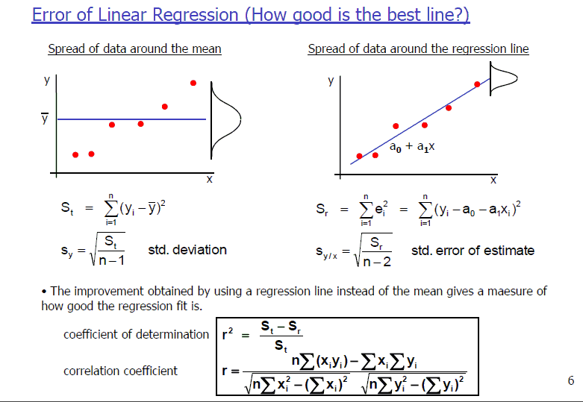
INTERVAL ESTIMATES

Slide 25
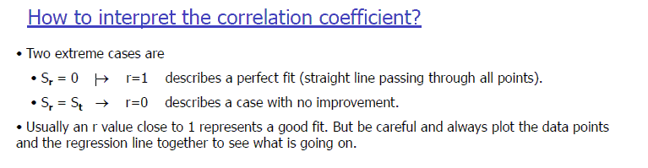

Slide 26
Conditional distribution
A conditional distribution is a distribution of a variable given a particular value of another variable. For example, a conditional distribution of number of widgets made exists for each possible value of number of seconds to put the form board together. Conceptually, suppose that an infinite number of applicants had made the same score of 18 on the form board test. If everyone was hired, not everyone make the same number of widgets three months later. The distribution of scores which results would be called the conditional distribution of Y (widgets) given X (form board). The relationship between X and Y in this case is often symbolized by Y |X. The conditional distribution of Y given that X was 18 would be symbolized as Y |X=18.
It is possible to model the conditional distribution with the normal curve. In order to create a normal curve model, it is necessary to estimate the values of the parameters of the model, mu and sigma.
for x=18, y=mu= 40.01-.957*18= 22.78
The standard error of estimate is often used as an estimate of d _{Y |X} for all the conditional distributions

Slide 27
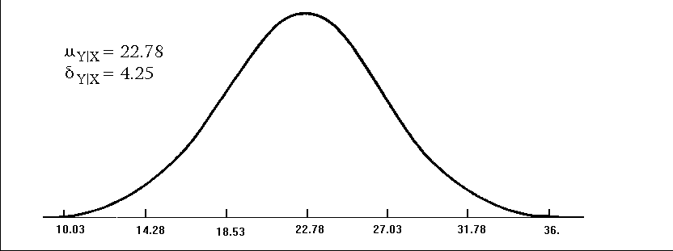
Conditional distribution
The standard error of estimate is often used as an estimate of ‘sigma’ for all the conditional distributions.
This assumes that all conditional distributions have the same value for this parameter.
One interpretation of the standard error of estimate, then, is an estimate of the value of ‘Sigma’ the ‘Std Deviation’ for all possible conditional distributions or values of X.
The conditional distribution which results when X=18 is presented below.

Slide 28
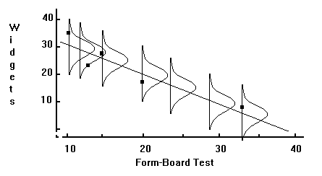
Conditional distribution
It is somewhat difficult to visualize all possible conditional distributions in only two dimensions, although the following illustration attempts the relatively impossible. If a hill can be visualized with the middle being the regression line, the vision would be essentially correct.
The conditional distribution is a model of the distribution of points around the regression line for a given value of X. The conditional distribution is important in this text mainly for the role it plays in computing an interval estimate.

Slide 29
INTERVAL ESTIMATES
The error in prediction may be incorporated into the information given to the client by using interval estimates rather than point estimates. A point estimate is the predicted value of Y, Y'. While the point estimate gives the best possible prediction, as defined by the least squares criterion, the prediction is not perfect. The interval estimate presents two values; low and high, between which some percentage of the observed scores are likely to fall. For example, if a person applying for a position manufacturing widgets made a score of X=18 on the form board test, a point estimate of 22.78 would result from the application of the regression model and an interval estimate might be from 14.25 to 31.11. The interval computed is a 95 per cent confidence interval. It could be said that 95 times out of 100 the number of widgets made per hour by an applicant making a score of 18 on the form board test would be between 14.25 and 31.11.
Other sizes of confidence intervals could be computed by changing the value of z.

Slide 30

Confidence and prediction intervals for forecasted values
The 95% confidence interval for the forecasted values ŷ of x is
where
The 95% confidence interval for the forecasted values ŷ of x is
This means that there is a 95% probability that the true linear regression line of the population will lie within the confidence interval of the regression line calculated from the sample data.

Slide 31
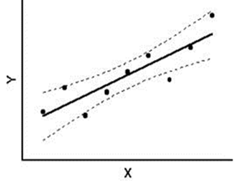
Confidence Interval
In the graph above linear regression line is calculated to fit the sample data points. The confidence interval consists of the space between the two curves (dotted lines). Thus there is a 95% probability that the true best-fit line for the population lies within the confidence interval (e.g. any of the lines in the figure on the right above).

Slide 32
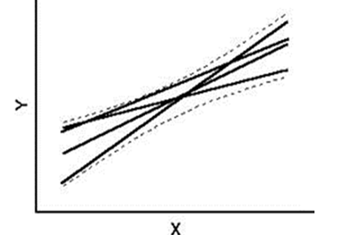
Prediction Interval
There is also a concept called prediction interval. Here we look at any specific value of x, x0, and find an interval around the predicted value ŷ0 for x0 such that there is a 95% probability that the real value of y (in the population) corresponding to x0 is within this interval (see the graph on the right side of Figure 1).

Slide 33

Prediction Interval cont..
The 95% prediction interval of the forecasted value ŷ₀ for x₀ is
where the standard error of the prediction is

Slide 34
In regression analysis, you'd like your regression model to have Significant Variables and to produce a High R-squared value.
This low P value / high R² combination indicates that changes in the predictors are related to changes in the response variable and that your model explains a lot of the response variability. This combination seems to go together naturally.
But what if your regression model has significant variables but explains little of the variability? It has low P values and a low R-squared.

Slide 35
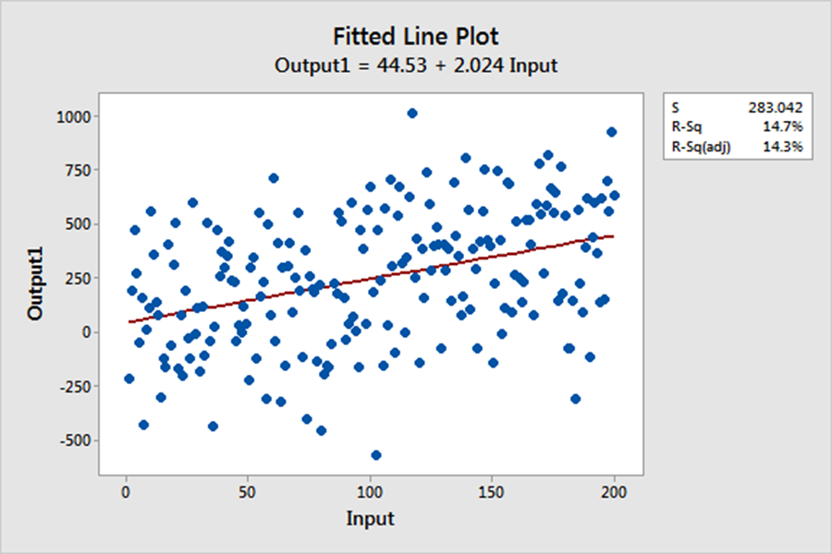
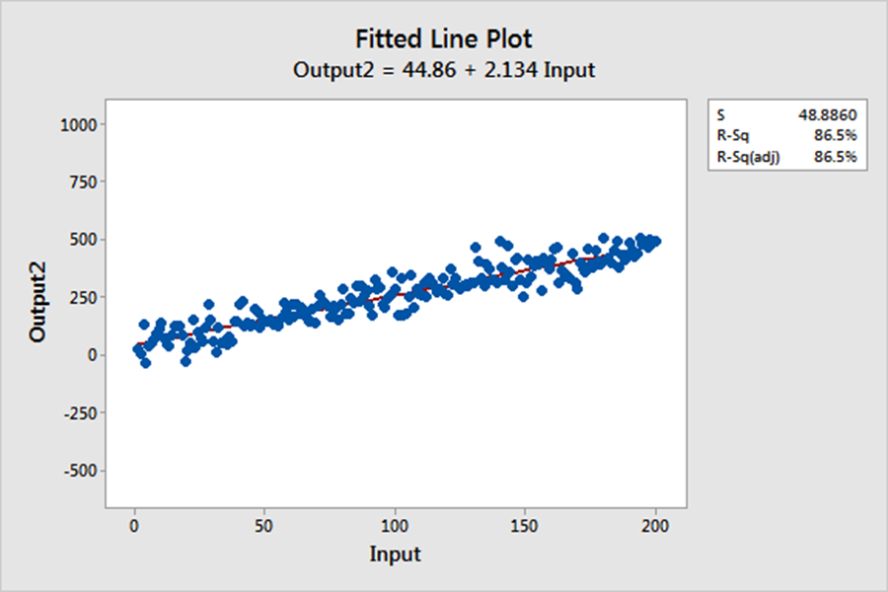

Slide 36
The two regression equations produce nearly identical predictions. However, the differing levels of variability affect the precision of these predictions.
The coefficients estimate the trends while R-squared represents the scatter around the regression line.
The interpretations of the significant variables are the same for both high and low R-squared models.
Low R-squared values are problematic when you need precise predictions.

Slide 37
How High Should R-squared Be in Regression Analysis?
If your main goal is to determine which predictors are statistically significant and how changes in the predictors relate to changes in the response variable, R-squared is almost totally irrelevant.
Suppose you model the relationship between Input and Output. You find that the p-value for Input is significant, its coefficient is 2, and the assumptions pass muster.
These results indicate that a one-unit increase in Input is associated with an average two-unit increase in Output. This interpretation is correct regardless of whether the R-squared value is 25% or 95%!
Asking “how high should R-squared be?” doesn’t make sense in this context because it isn’t relevant.

Slide 38

THANK YOU!

